Slide 1



WELCOME TO Final Year B. Tech Project

Slide 2


SANT GAJANAN MAHARAJ COLLEGE OF ENGINEERING MAHAGAON, SITE-CHINCHEWADI
Department of Computer Science and Engineering
PROJECT TITLE : “Uncovering Industrial Trends By Analyzing data Using Power BI”
Guided By:-Asst. Prof. S. G. Swami
Group Members:
Roll No. | NAME | PRN No
42 | Borgave Revati Sanjay | 2020076665
43 | Patil Devendra Sunil | 2020081860
44 | Sutar Abhishek Rajaram | 2021076912
45 | Goilkar Rohan Ravindra | 2020080792

Slide 3
INDEX
Introduction
Proposed System
Snapshots
Requirements
Conclusion
References

Slide 4
INTRODUCTION
We're diving into a project to boost sales and smart decision-making for skateboard company.
Using a cool tool called Power BI, we'll look at company’s sales numbers, who's buying our boards, and how our marketing is doing.
The idea is to create dashboards that show us the important stuff in a clear and simple way. This way, we can make smarter choices, find out what our customers really like, and keep our skateboards rolling off the shelves!

Slide 5
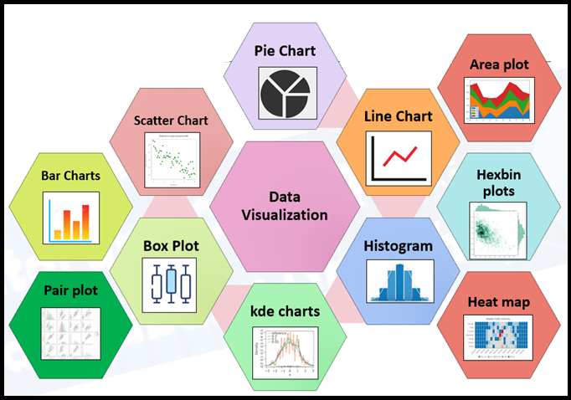

PROPOSED WORK
Data storing
Data cleaning
Data Transforming
Data-visualization

Slide 6
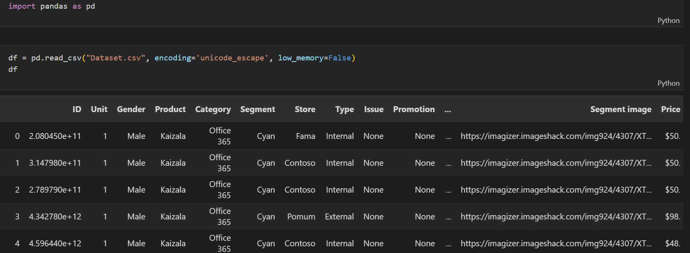
SNAPSHOTS

Slide 7
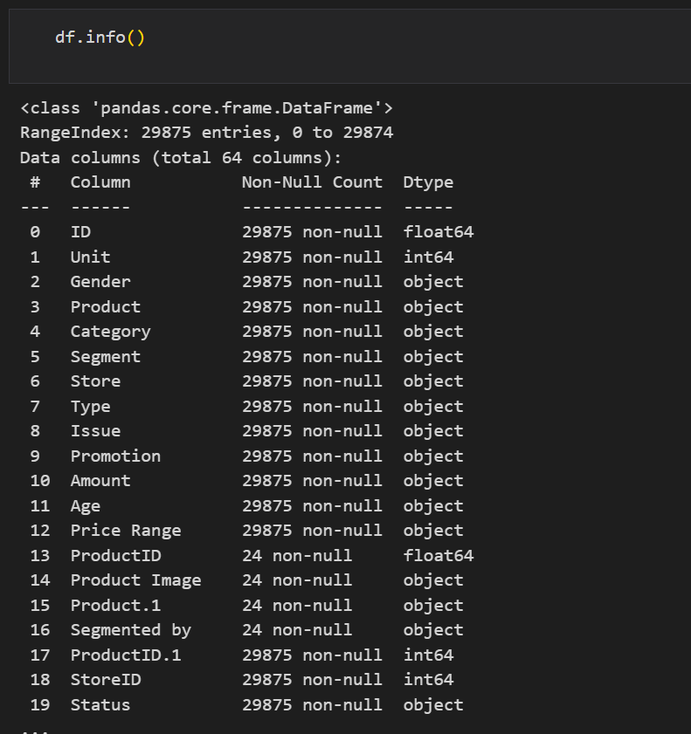

Slide 8
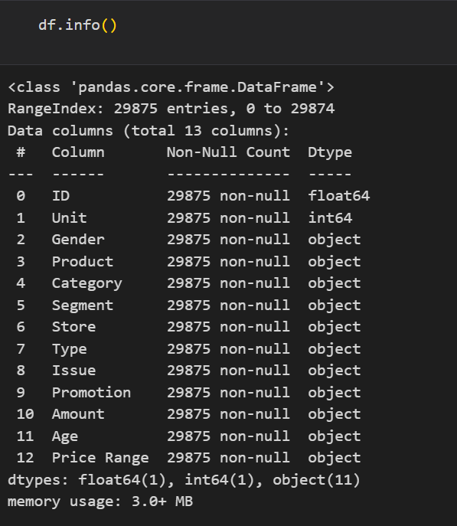

Slide 9
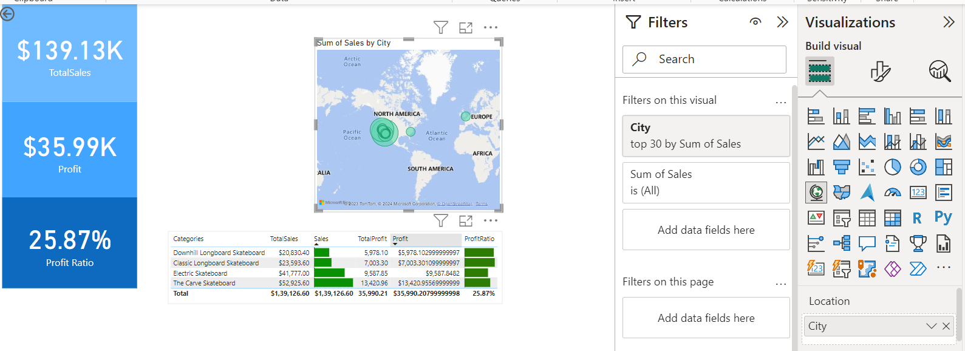

Slide 10
REQUIREMENTS
Hardware Requirement:
Processor : Intel core i3
Hard disk : Minimum 20GB
RAM : Minimum 4GB
Software Requirement :
Operating System: Windows 8
Dataset Storage: MySQL or SQL Server
BI Tool: Power BI, Power BI Report Services

Slide 11
CONCLUSION
In conclusion, the skateboard company currently faces significant challenges in optimizing sales and minimizing returns due to a lack of data-driven insights and an absence of essential tools like an interactive analytics dashboard. By addressing these issues and implementing a robust data analytics infrastructure, the company can not only identify regional trends but also enhance marketing strategies. These improvements are vital for achieving increased sales and reducing returns, ultimately leading to a more successful and efficient operation.

Slide 12
REFERENCES
Web references:
https://learn.microsoft.com/en-us/training/modules/introduction-power-bi/
https://www.youtube.com/watch?v=-_DJPRrFQXI&t=339s

Slide 13
THANK YOU!
ANY QUESTIONS?

